Slide 1
Machine Learning AdaBoosting Algorithm
It is an ensemble learning method which combines all the weak models and predict the strong output.
It improves performance by:
Training models one after another.
Giving more focus (weight) to errors made by previous models.
Combining all the models outputs intelligently.

Slide 2
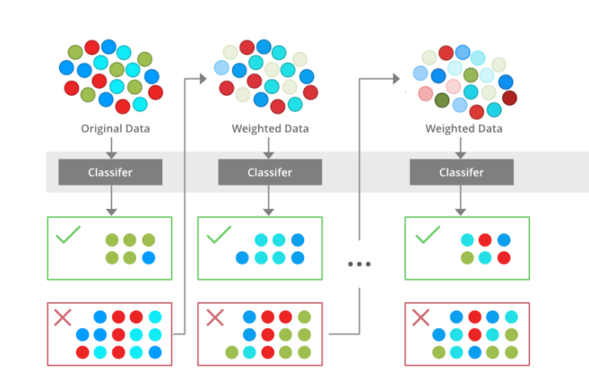
Adaboost Algorithm
Takes the errors from the 1st weak model & works on the errors in the 2nd model, takes the 2nd model errors and works on the 3rd model.
Finally, combine all the models provides the best regression prediction.
Mostly in decision tree.
https://www.geeksforgeeks.org/machine-learning/implementing-the-adaboost-algorithm-from-scratch/

Slide 3
Scenario Actual Weight : 70 Kg
1st Weak Model : It predicts the weight as 60Kg. Here the error is+10Kg
2nd Model : In mind of +10Kg errors, it takes +8 and predicts as 60 + 8 = 68. Here the error is 2Kg.
3rd Model : It takes +2 and predicts the model as 70 Kg from the previous model.
60 + 8 + 2 = 70 Kg

Slide 4
Algorithm Procedure
from sklearn.ensemble import AdaBoostRegressor
regressor = AdaBoostRegressor(random_state=0, n_estimators=100)
regressor.fit(X_train, Y_train)

